Slide 1
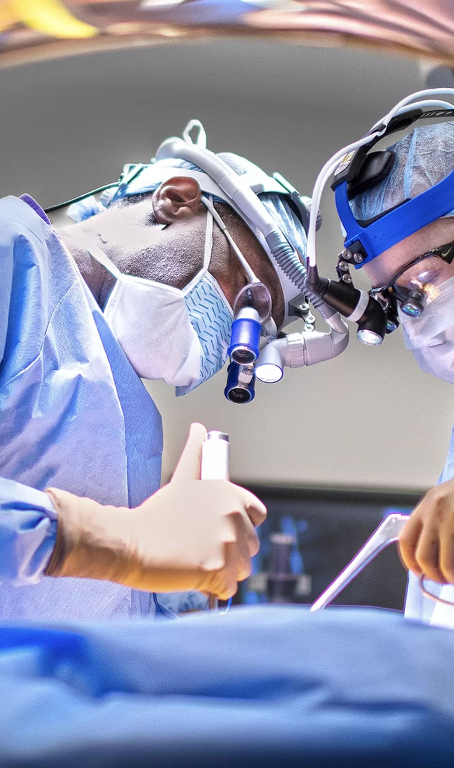
Segmentation on 4D Brain MRIs
Teo Zeng
Oct 31, 2024

Slide 2
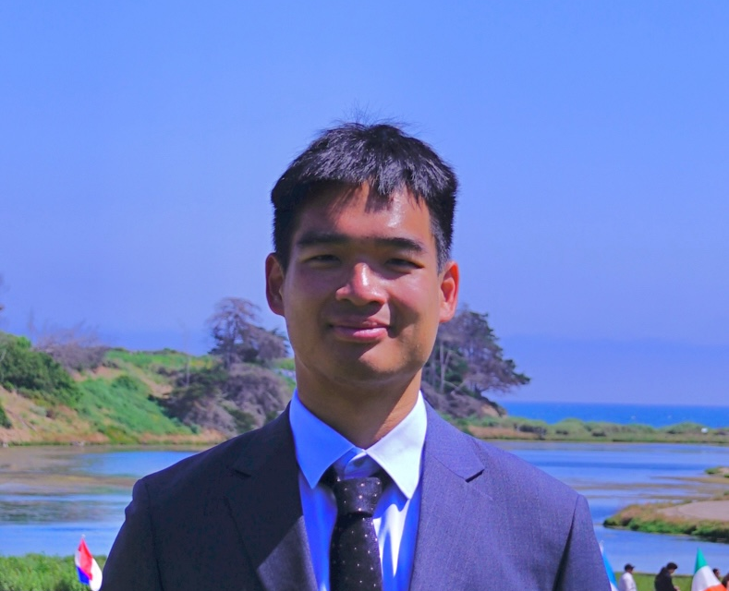
About Teo Zeng
Professional Snapshot
M.S. in Data Science from NYU;
B.S. in Applied Mathematics and Statistics from UCSB
Experienced AI/ML Engineer and Data Scientist with a knack for problem-solving and innovation.
Passionate Explorer & Innovator
🏀 Basketball Enthusiast
📸 Photography Lover
⛰️ Avid Hiker & Traveler
Exploring the world, one step at a time, and turning data into meaningful insights.
2

Slide 3
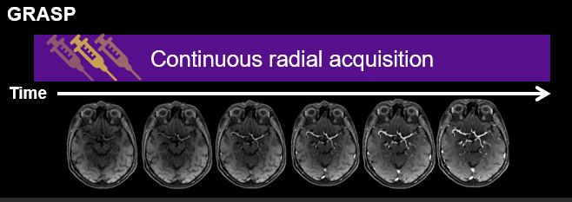
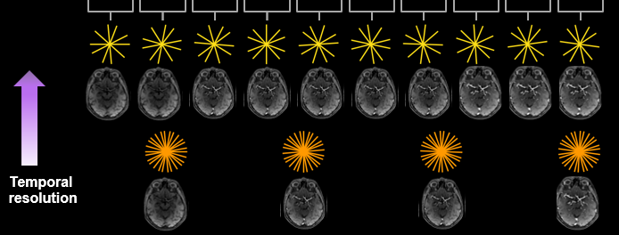
Project Motivation
GRASP (Golden Angle Radial Sparse Parallel MRI)
A continuous imaging technique developed by NYU Center of Biomedical Imaging
Enables examination to patients who previously can not be imaged
Because data was acquired continuously, injection time of contrast agent, a major source of error, was insignificant
Creates a “movie” of 3D MRI images, provides extra information for diagnosis over conventional MRI
Implemented into the Imaging workflow at NYU with over 200,000 patients
Notes:
GRASP description
Workflow simplification

Slide 4
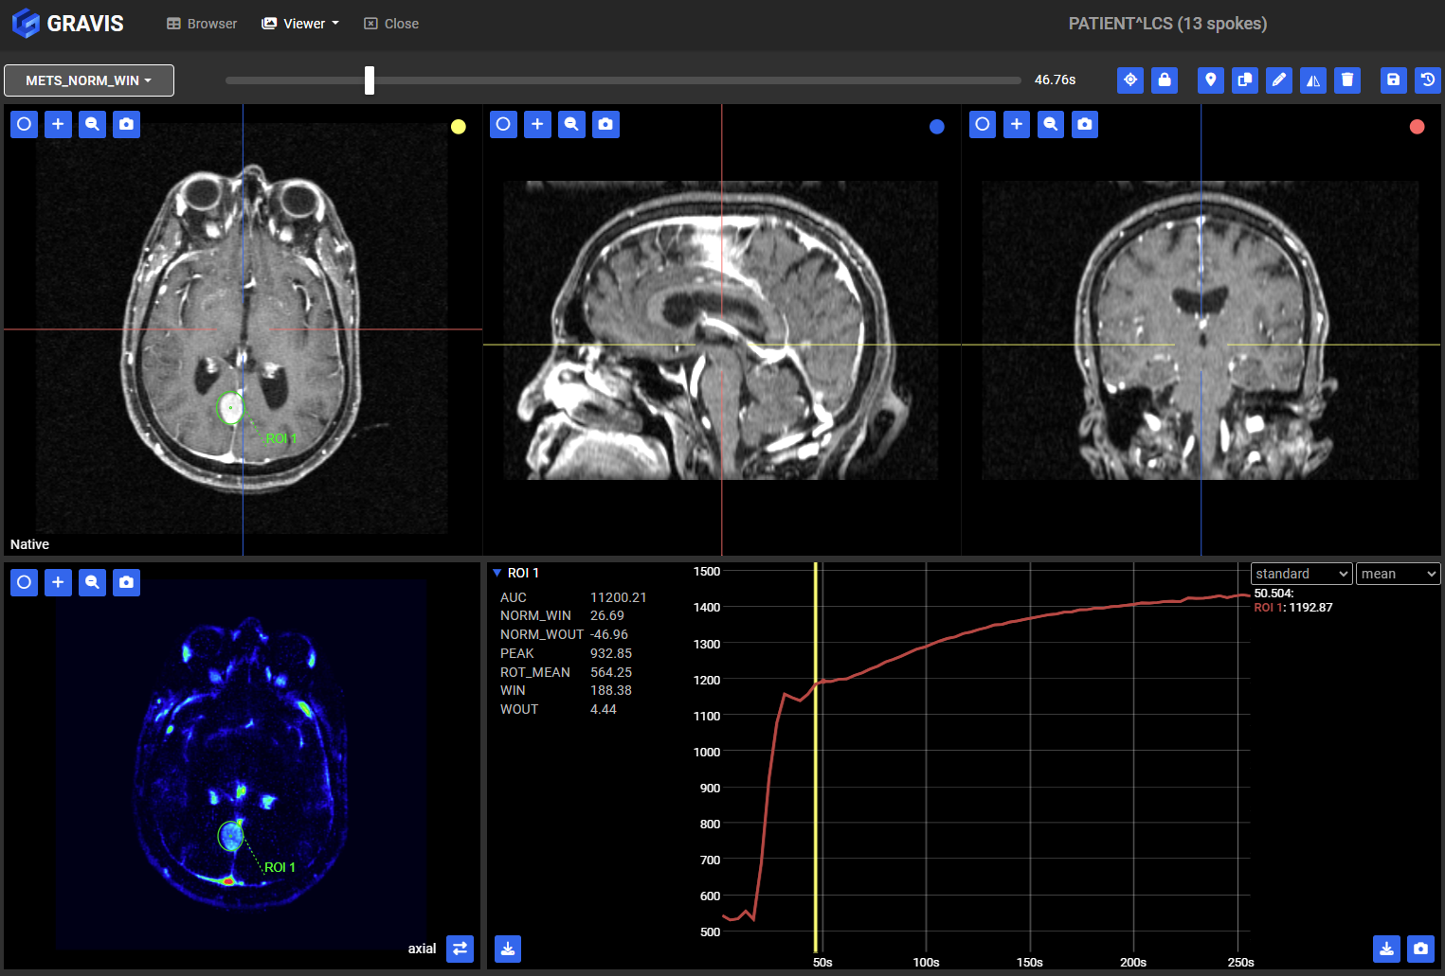
Project Motivation
GRAVIS Software
“Web-based open-source visualization and annotation tool designed for use for large, four-dimensional DICOM volumes”
Capable of viewing GRASP data on regular desktops
Backend written in Django (python), providing the capability to run AI models developed with Pytorch or MONAI

Slide 5
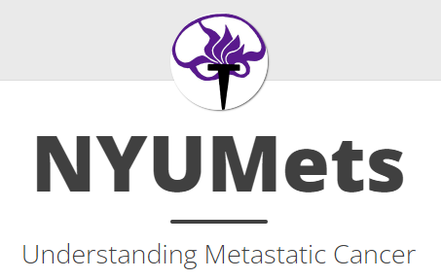


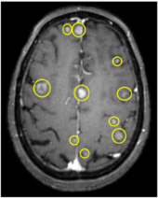
Building a Dataset
NYU imaging archives
GRASP Brain Mets Dataset:
Combined From
NYU Mets dataset (https://nyumets.org/)
GRASP DCE MRI datasets from NYU archives
638 matched datasets with CT1 images with segmentation ground truths and corresponding GRASP data
Segmentations
MRI images
GRASP
GRASP
Brain Mets dataset

Slide 6
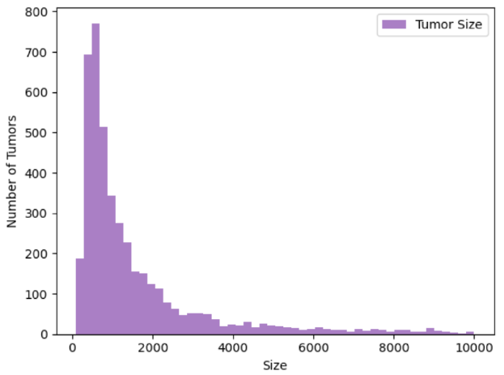
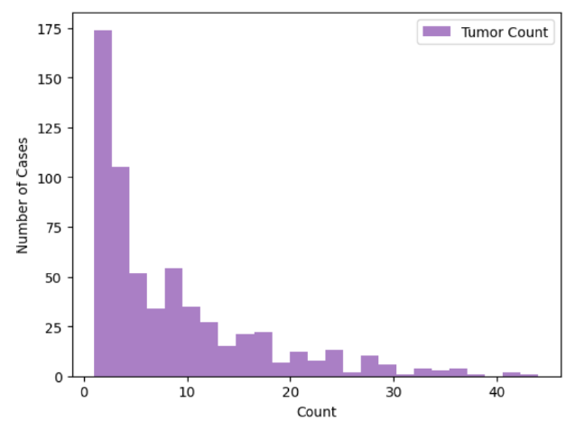
Previous Works
NYU CDS Capstone Project Fall 2023
Intensity normalization
Padding
Segmentation binarization
Trained, evaluated an UNet model on the NYU Mets data (~0.4 Dice Score)
Improvements previously identified:
Skull stripping
Use 4D data to train a new model

Slide 7
Project Objectives
Main Objective: Train an AI model to perform segmentation of tumors on the GRASP Brain Mets Dataset using GRASP data
Key project tasks
Data preparation (normalization, padding, binarization, registration etc.)
Skull stripping
Model implementation (3D/ 4D)
Model evaluation

Slide 8
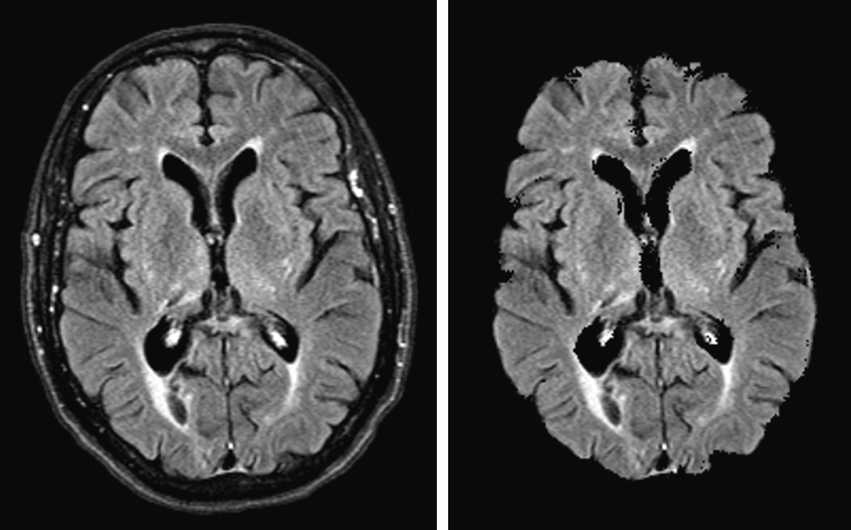
Skull-Stripping
Removing non-brain tissues (skull, scalp) from brain MRI images to isolate the brain for accurate analysis
Advantages
Focus on brain tissues, reduce false positives
Reduce data complexity

Slide 9
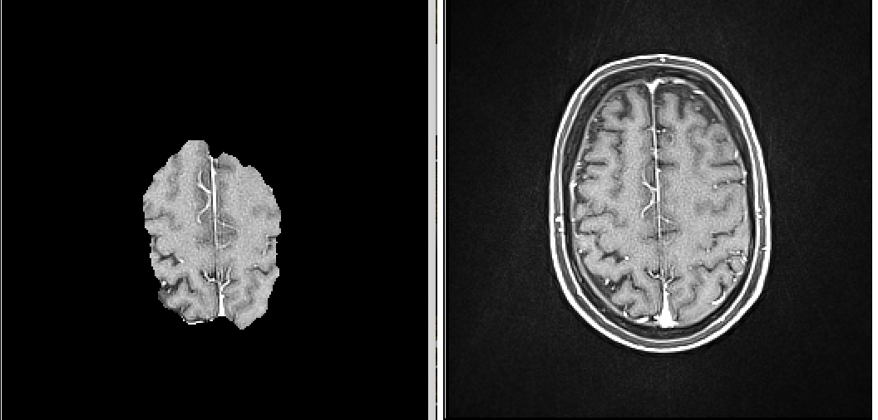
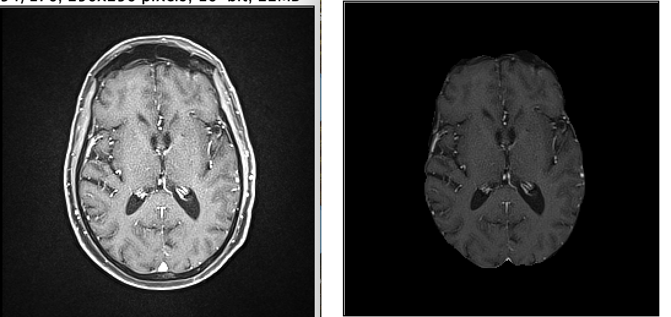
Experimenting with Skull-Striping Techniques
Initial Approach: ANTs Package
Issue: Outdated package/method
Limitation: poor performance, often excludes the cerebellum from the mask
Recent Approach: DeepBET Model (Fisch et al 2023)
Advantage: Significantly better performance in skull stripping
Outcome: Despite improvements, overall model performance remains unchanged (dice remains ~0.4)

Slide 10
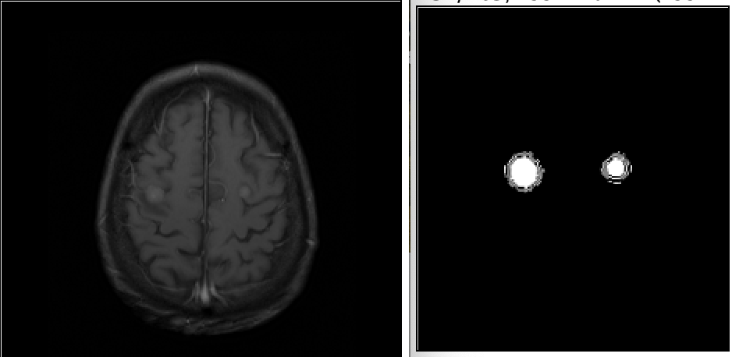
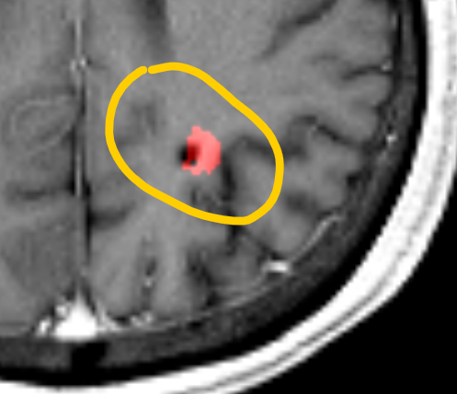
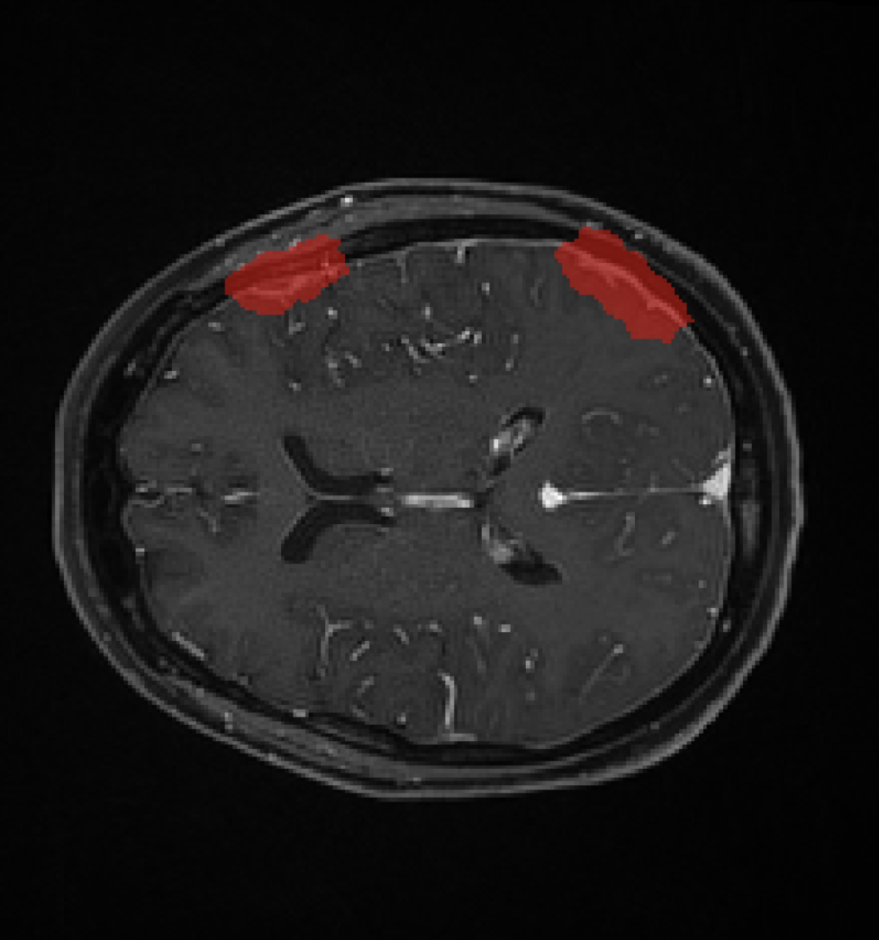
Issues Identified with the GRASP Brain Mets Dataset
“Ring” shaped & oversized ground truth segmentations
Can be seen in the larger tumors (> 400 voxels)
Shifted ground truth segmentations
May due to registration when constructing the dataset
Complete mismatch, with tumors outside the brain mask
These cases were identified and marked (~10 cases)

Slide 11
Experimenting with Different Binarization Levels
Initial Approach: set a threshold of 0
Keeps all the information, but usually the ground truth is larger than the tumor
Evaluated more aggressive binarization thresholds
Experimented 0.1, 0.3, 0.5, 0.7, 0.9, 0.95
Gaps in voxels
Increased loss of information with increasing thresholds
Binary Erosion
Removing voxels on tumor boundaries
Loss of small lesions and tumors

Slide 12
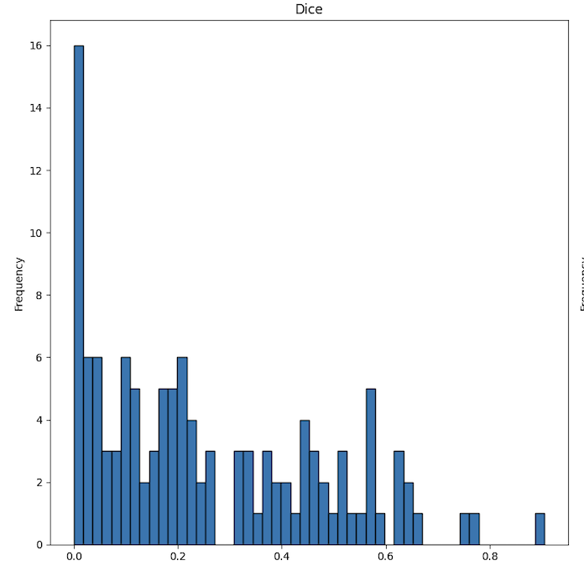
Solution: Training on a Smaller Dataset
Predicting on Full Dataset: Utilizing our current best model, predictions were made on the entire dataset consisting of 613 cases. Cases were filtered using an aggressive threshold (Dice coefficient > 0.5).
Filtered Patient Cases: From the initial predictions, 213 patient cases met the threshold criteria.
Model Retraining: Retraining was conducted using both the nnUNet model and the SAM model on the filtered dataset.

Slide 13
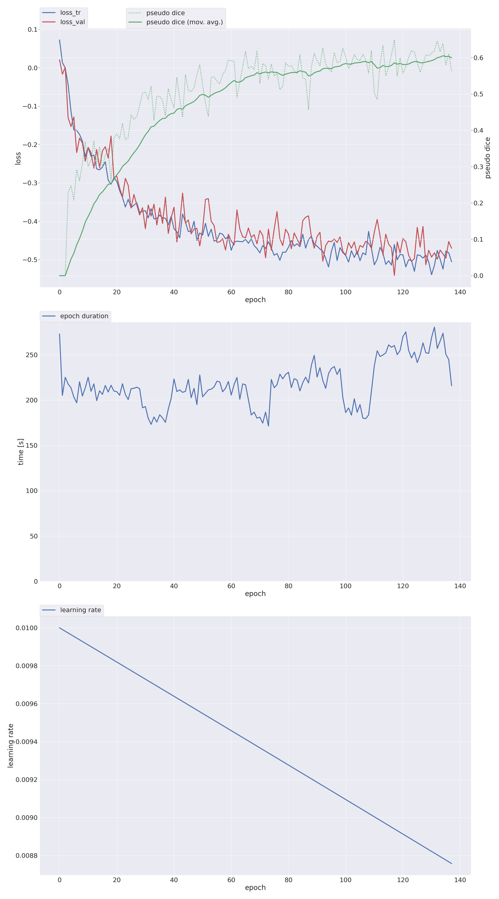
Training on a smaller Dataset
nnUnet
Training Dice Score: Achieved a training dice score exceeding 0.6, compared to the previous training dice score of 0.5.
Testing Dice Score: Improved testing dice score to from 0.42 to 0.56, representing a 30% enhancement over previous results on the full dataset.

Slide 14
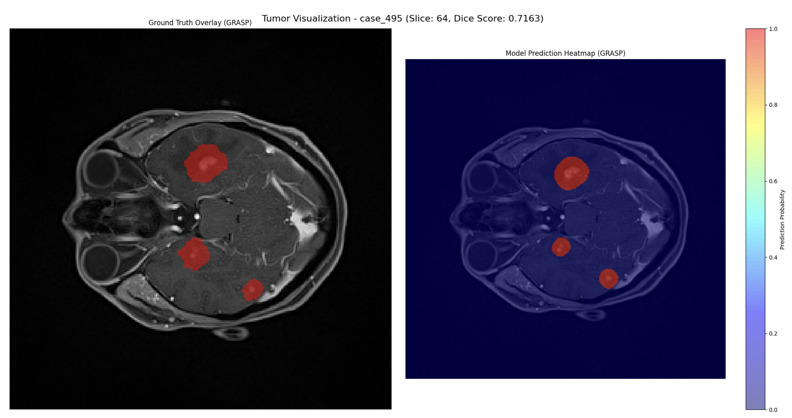
Model Prediction Examples

Slide 15
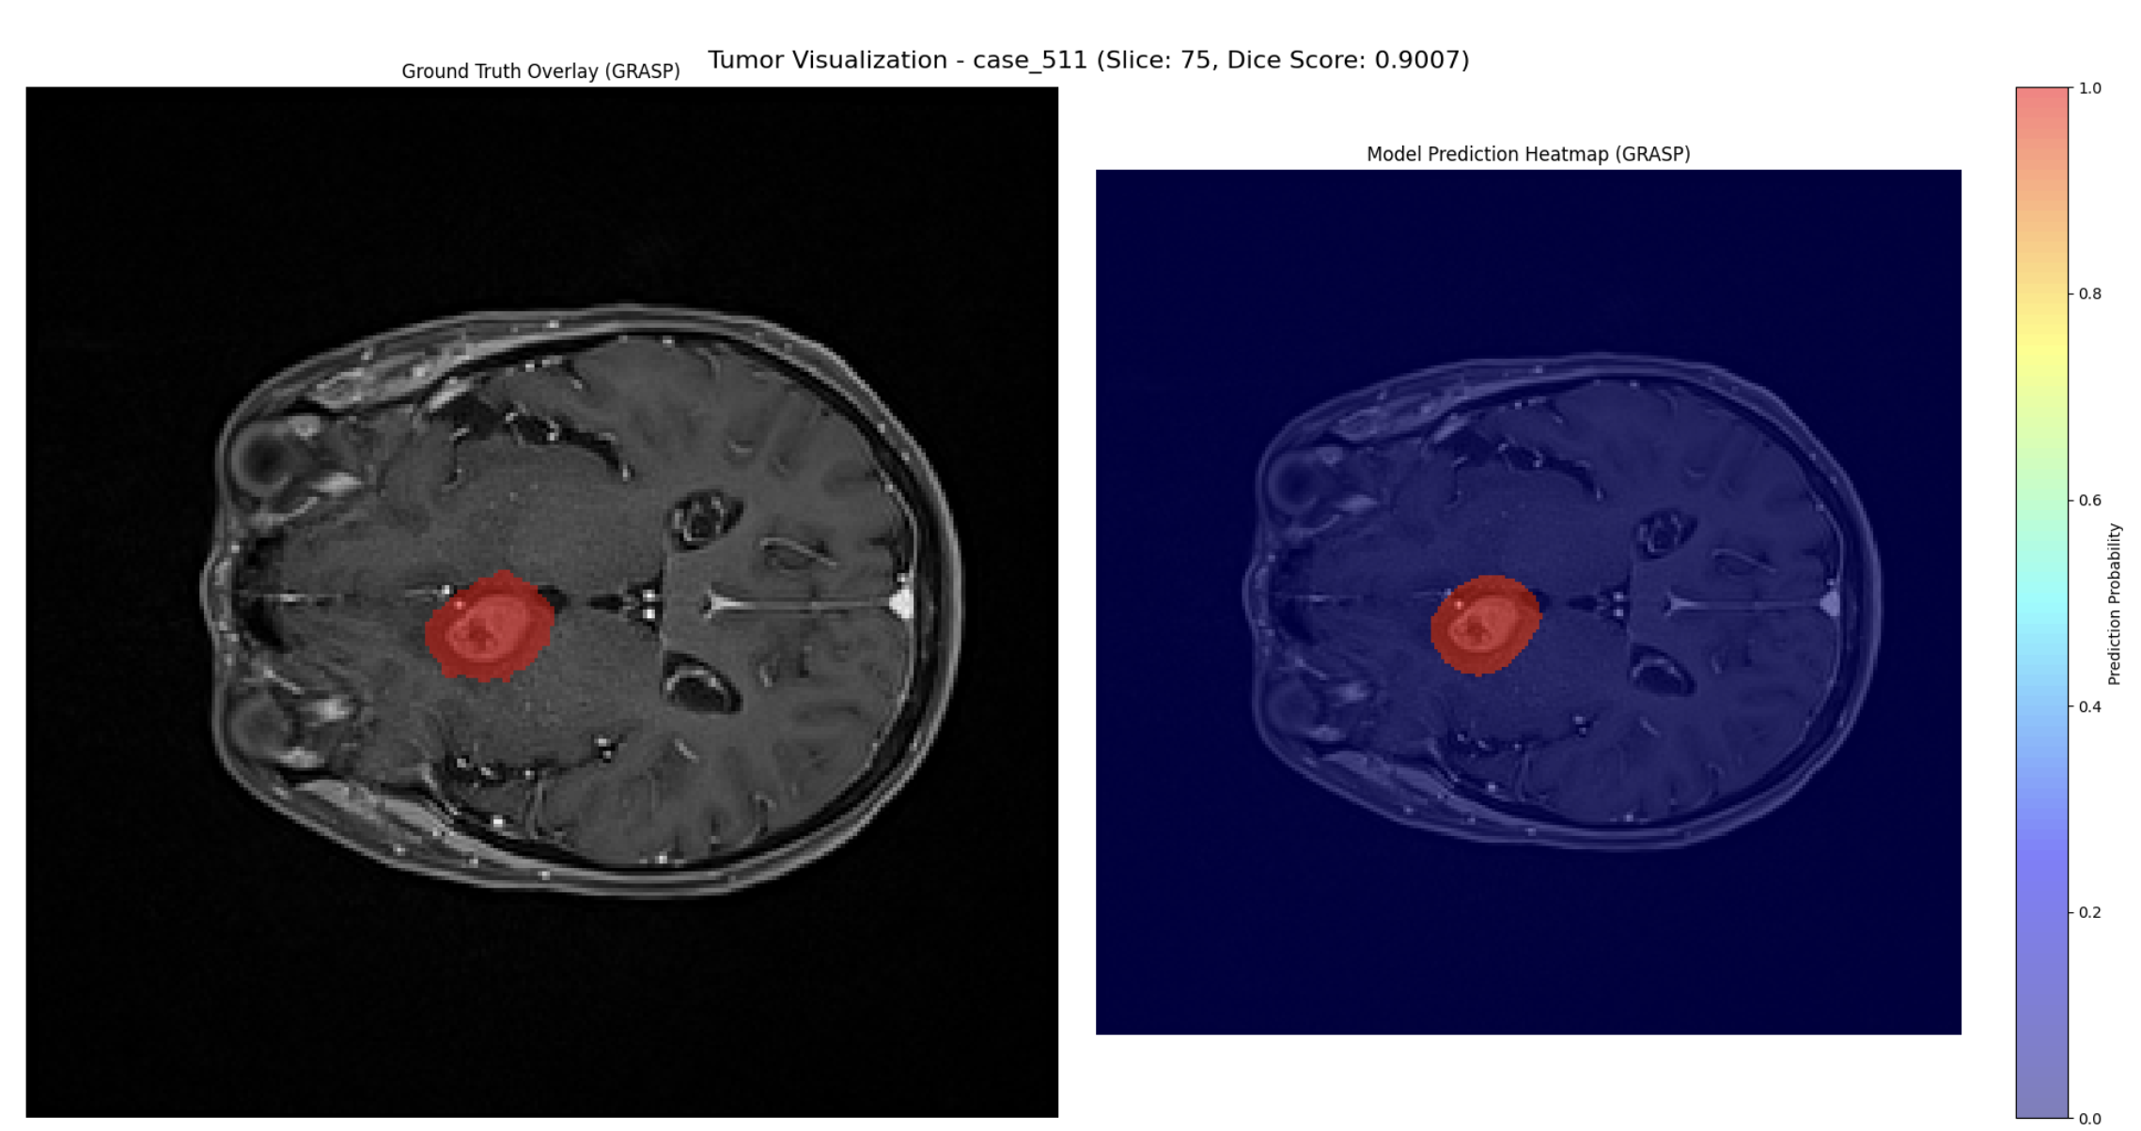
Model Prediction Examples

Slide 16
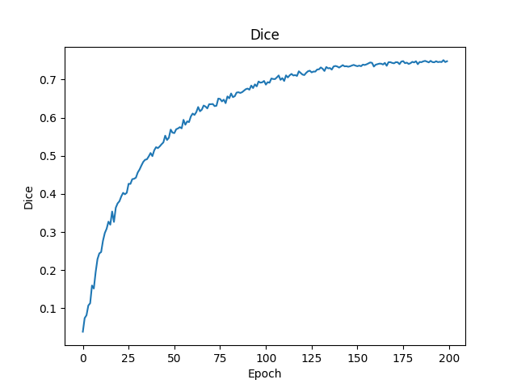
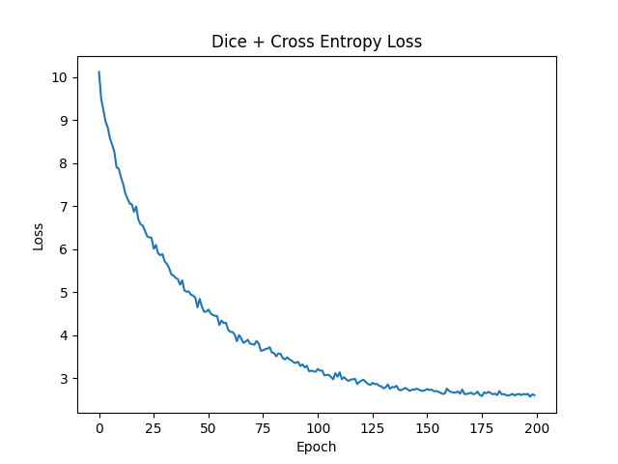
Trying Alternate Models
Med-SAM 3D
Fine-Tuned on a weights specifically trained on brain images
Training Dice Score: Achieved a training dice score exceeding 0.7
Testing Dice Score: Does not perform well on the testing data with testing dice of 0.22

Slide 17
Future Directions
Improvement on the dataset
Perform manual correction on the dataset
Train a bounding box approach with Pretrained SAM with augmentation
Foundation Models like (Clip, DinoV2)
Find a more sophiticated way to binarize the ground truths
Treat small lesion and tumors differently

Slide 18

Thank you

